Slide 1
Bala Vignesh Bala Subramanian
File created on: 1/16/21 7:07:52 AM EST

Slide 2
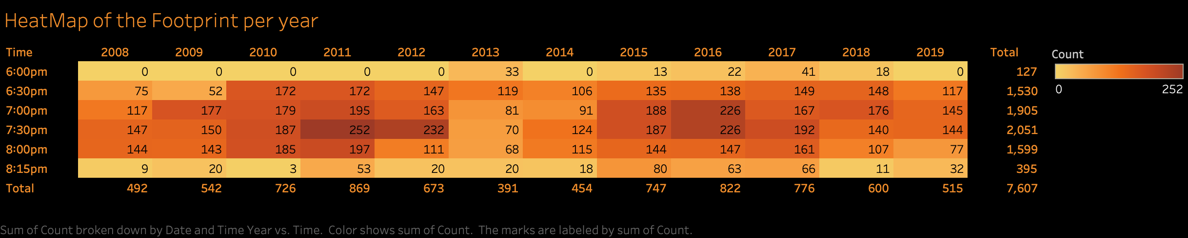

Slide 3
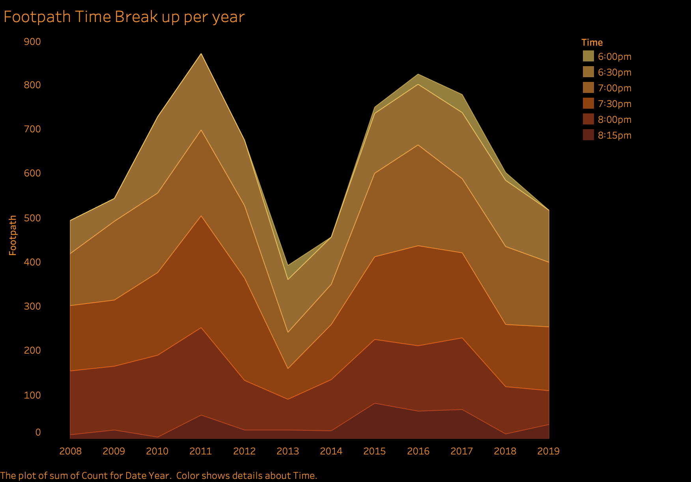

Slide 4
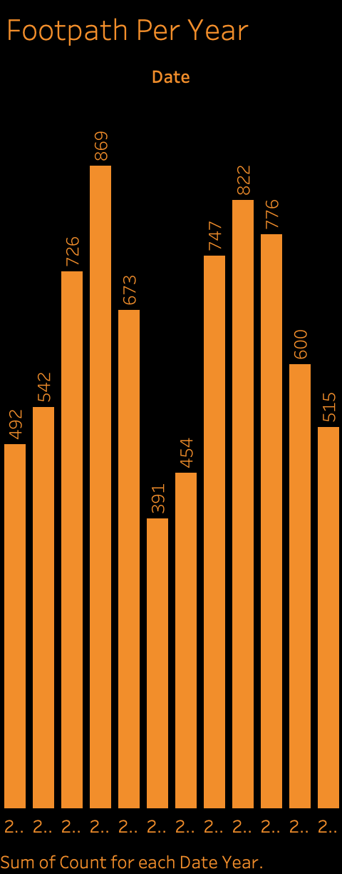

Slide 5
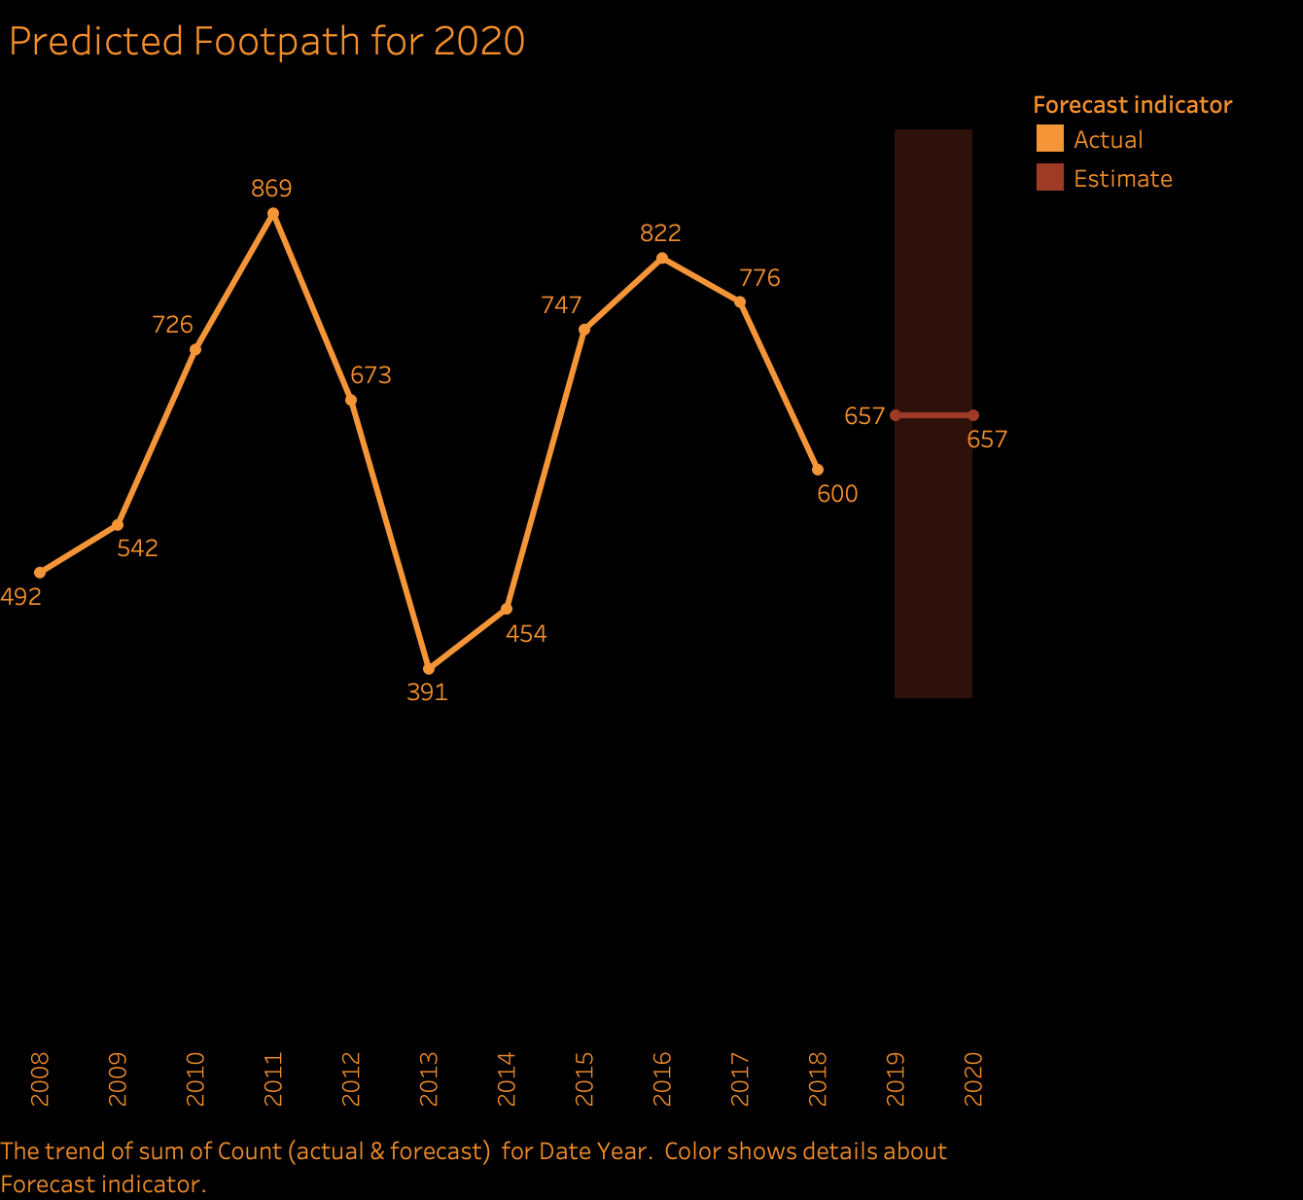

Slide 6
